Slide 1

CMSC 137
Data Communications and Networking
Lecture Module
25 – Other Wireless Networks

Slide 2
Module 25: Other Wireless Networks
Joseph Anthony C. Hermocilla
Lecturer

Slide 3
Cellular Networks: Overview

Slide 4
Overview
Designed to provide communications between two moving units, called mobile stations or between one mobile unit and one stationary unit, called land unit
A service provider must be able to locate and track caller, assign a channel to the call, and transfer the channel from base station to base station as the caller moves out of range

Slide 5
Overview
To enable tracking, cellular service area is divided into small regions called cells
Each cell has an antenna powered by a network station, called the base station
Each base station is controlled by a switching office, called a Mobile Switching Center (MSC) to coordinate communication between all base stations and the telephone central office

Slide 6
Overview
Cell size is not fixed, typical radius of 1 to 12 miles
Cell size is optimized to prevent interference of adjacent cell signals
Transmission power of each cell is kept low to prevent interfering with the signal

Slide 7
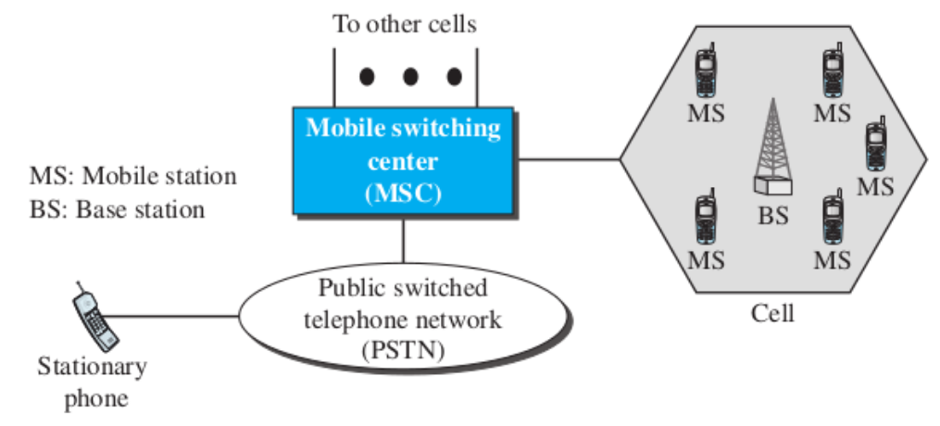
Overview

Slide 8
Cellular Networks: Operation

Slide 9
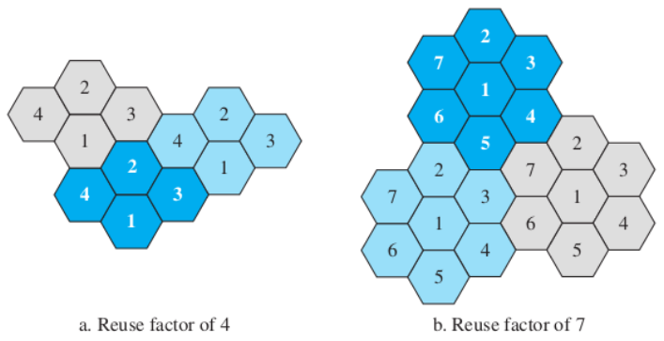
Frequency Reuse Principle
Number of cells define the pattern, cells with same number in a pattern can use the same set of frequencies

Slide 10
Transmitting
Caller enters a code of 7 or 10 digits (mobile number)
Mobile stations scans the band seeking a setup channel with a strong signal and sends the phone number to the closest base station using the channel
Base station relays the mobile number to the MSC, MSC sends data to the telephone central office
If called party is available, MSC assigns an unused voice channel to the call and the connection is established

Slide 11
Receiving
Telephone central office sends the number to the MSC
MSC searches for the location of the mobile station by sending query signals to each cell, called paging
Once the mobile station is found, MSC transmits a ringing signal
When mobile station answers, voice channel is assigned to the call allowing voice communication to begin

Slide 12
Handoff
During conversation, mobile station may move from one cell to another – signal may become weak
MSC monitors signal level every few seconds, if signal is weak MSC finds a new cell then transfers the call to the new channel
Hard handoff – mobile station only communicates with one base station
Soft handoff – mobile station can communicate to both base stations in the old and new cells

Slide 13
Roaming
Service provider has limited coverage
Neighboring service providers can provide extended coverage through a roaming contract

Slide 14
Cellular Networks:
First Generation (1G)

Slide 15
AMPS
Designed for voice communication using analog signals
Advanced Mobile Phone System (AMPS) – used in North America, uses FDMA
Uses ISM 800-MHz band
  Forward channel (base to mobile) - (869-894 MHz)
  Reverse channel (mobile to base) - (824-849 MHz)

Slide 16
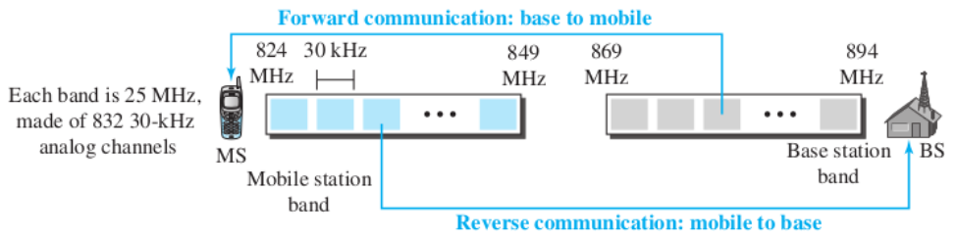
AMPS
21 channels are used for control
Frequency reuse factor is 7

Slide 17
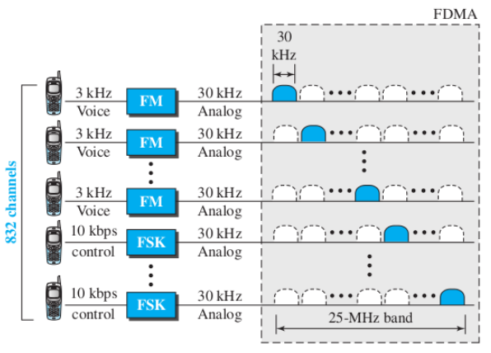
AMPS
Uses FM(voice channel) and FSK(control channel) )

Slide 18
Cellular Networks:
Second Generation (2G)

Slide 19
2G
Designed for digitized voice communications
Systems: D-AMPS, GSM, IS-95

Slide 20
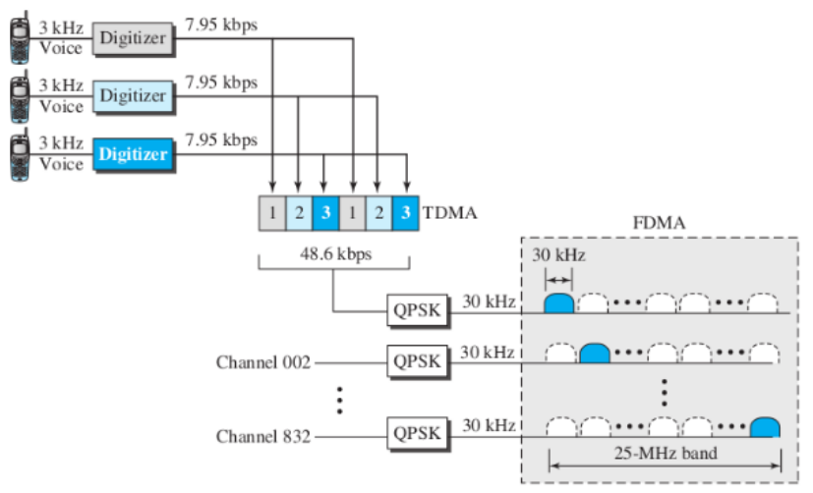
D-AMPS

Slide 21
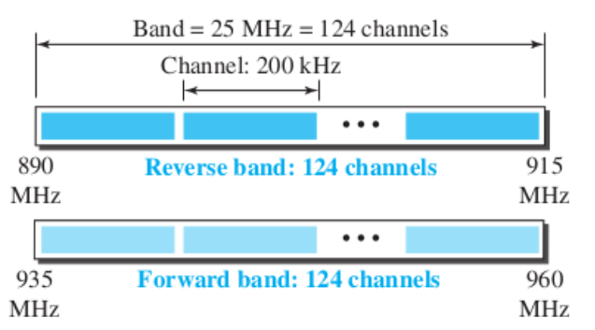
GSM
Global System for Mobile Communication (GSM) – Europe-based
Reuse factor: 3

Slide 22
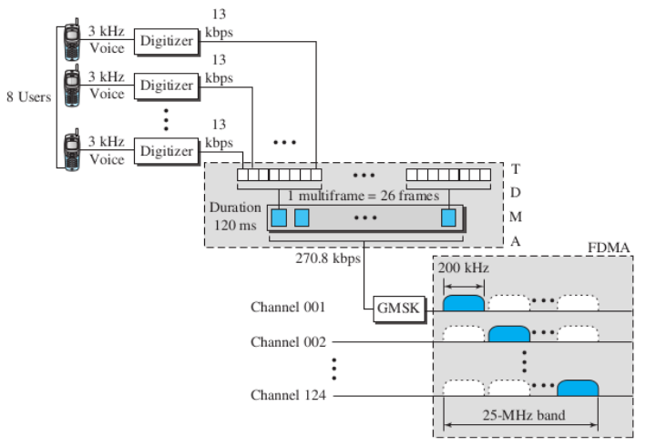
GSM

Slide 23
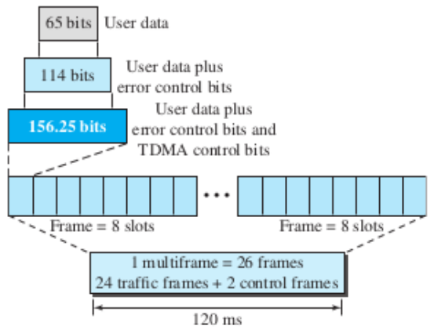
GSM
Overhead

Slide 24
Cellular Networks:
Third Generation (3G)

Slide 25
3G
Provide both digital data and voice communication
Started in 1992, Internet Mobile Communication 2000 (IMT-2000)

Slide 26
IMT-2000 Blueprint
Voice quality comparable to that of the existing PSTN
Data rate of 144 kbps for moving car, 384 kbps for pedestrians, 2 mbps for office
Support for packet-switched and circuit-switched data services
A band of 2 GHz
Bandwidths of 2 MHz
Interface to the Internet

Slide 27
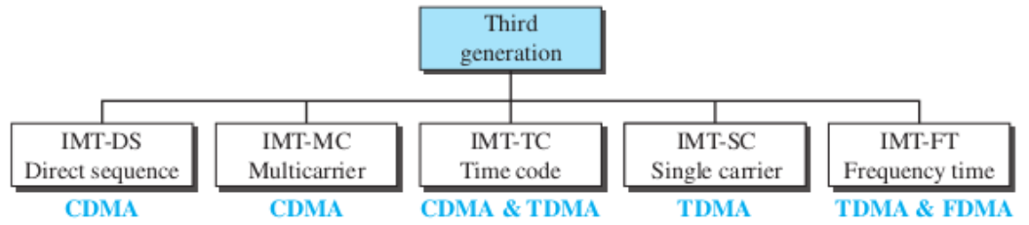
IMT-2000 Radio Interfaces

Slide 28
Cellular Networks:
Fourth Generation (4G)

Slide 29
4G Objectives
Spectrally efficient system
High network capacity
100Mbps for moving car, 1Gbps for stationary users
Smooth handoff across heterogeneous networks
Seamless connectivity and global roaming
All IP, packet-switched, networks

Slide 30
4G Features
Access Scheme
  Orthogonal FDMA (UMTS), Interleaved FDMA (UMTS), Multicarrier CDMA (IEEE 802.20)
Modulation
  64-QAM for LTE
Radio System
  Software Defined Radio (SDR)
Antenna
  Multiple-input Multiple-output (MIMO), Mutiuser MIMO

Slide 31
Cellular Networks:
Fifth Generation (5G)

Slide 32
5G Features
Uses Orthogonal FDM encoding
Uses millimeter waves (wavelength)
limited range, can be blocked by materials like walls and windows
health concerns?
Can use low, medium, or high frequency bands (high frequency bands, 24-47 GHz, can achieve peak at 20 Gbps data rate)
Internet of Things
Useful for urban areas

Slide 33
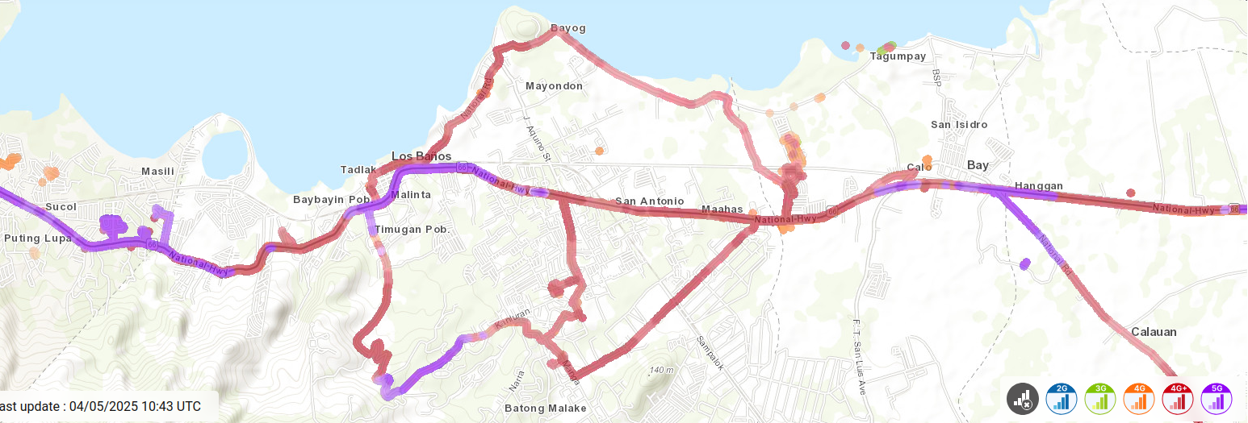
5G
https://www.nperf.com/en/map/PH/-/1999180.SmartSunTNT-Mobile/signal?ll=14.180933667524748&lg=121.24717712402345&zoom=14

Slide 34
Satellite Networks

Slide 35
Overview
Combination of nodes: artificial satellites, Earth stations, end-user terminals or phones
Similar to cellular networks, Earth is divided into cells
Useful in underdeveloped regions

